Slide 1
Anaemia AI Analysis
Environmental Factors Relating to Anaemia using National Health & Nutrition Examination Survey Dataset
Notes:
This presentation will explore the use of AI in identifying and analyzing the factors contributing to anaemia. I will delve into the National Health & Nutrition Examination Survey Dataset to uncover significant patterns and insights.

Slide 2
Background
A Silent Global Burden:
Affects 1.62 billion people, or 24.8% globally.
Leads to fatigue, weakness, and health complications.
Socio-Economic Impact:
Reduces work productivity.
Escalates healthcare costs.
New Zealand's Growing Concern:
Complex interplay of genetics, nutrition, and health systems.
Urgent need for comprehensive understanding.
Commitment:
Unraveling the underlying factors.
Informed strategies for better health outcomes.
Notes:
Anaemia is a global health issue affecting billions. It's more than a medical condition; it's a socio-economic challenge that impacts productivity and inflates healthcare costs. In New Zealand, the interplay between genetics, nutrition, and healthcare systems necessitates a deep dive into the condition's root causes.

Slide 3
Research Problem
& Objectives
Research Problem:
Identifying key factors: demographic, environmental, medical.
Analyzing interconnections and impact on anaemia.
Study Objectives;
Isolate significant contributors to anaemia from 2014-2018.
Establish clear relationships with NHANES data insights.
Outcome Aim:
Inform healthcare policy with targeted data analysis.
Strengthen preventive and diagnostic measures in public health.
Enabling resource allocation for anaemia prevention programs.
Enriching the evidence base for clinicians and health officials.
Notes:
My research zeroes in on the significant factors influencing anaemia, utilizing the NHANES dataset. The goal is to identify key variables and their relationships, with the ultimate aim of informing healthcare policy and enhancing preventative and diagnostic measures.

Slide 4
Methodological
Approach
Data Source:
Utilizing NHANES: A rich, cross-sectional dataset.
Reflective of diverse populations and health variables.
Analytical Strategy:
Statistical models to decipher patterns and correlations.
Blood markers, lifestyle, socio-economic status under the lens.
Process:
Variable selection through feature importance analysis.
Pre-processing: Handling missing data with mean/mode imputation.
Objective:
Derive patterns that reveal anaemia's underlying factors.
Inform policy with concrete, data-driven evidence.
Notes:
My approach in this study using NHANES data reflects a wide demographic. The methodology involves rigorous statistical analysis, focusing on blood markers, lifestyle, and socio-economic factors, and aims to extract patterns crucial for policy-making.

Slide 5
Scope & Limitations
Scope of Research:
Analysis window: 2014-2018.
Focus on U.S. demographic - indicative insights for NZ.
Data Limitations:
NHANES data is cross-sectional; causality cannot be inferred.
Incomplete variables due to missing data points.
Geographical Consideration:
U.S. dataset may not fully encapsulate NZ's health landscape.
Cultural and health system differences acknowledged.
Towards Future Research:
Findings lay a foundation for localized NZ studies.
Highlights the need for ongoing data collection and analysis.
Notes:
My research, confined to the 2014-2018 NHANES data, acknowledges the limitations of applying U.S.-based findings to the New Zealand context. Despite these limitations, the study paves the way for more localized research.

Slide 6
Data Description
Dataset Composition:
A deep dive into 558 variables.
Selection focused on anaemia prediction.
Key Variables Analyzed:
Blood markers: WBC count, lymphocytes, and more.
Body metrics: Weight, height, BMI.
Lifestyle indicators: Physical activity levels, smoking status.
Data Preprocessing:
Rigorous cleaning: 323 columns dropped due to high null values.
Missing value imputation for robust analysis.
Feature Selection:
Employed Random Forest for feature importance (>0.005 threshold).
Retained influential variables for predictive modeling.
Notes:
I've delved into an extensive list of variables, focusing on those predictive of anaemia. Significant pre-processing was undertaken to ensure the robustness of our analysis, including feature selection via the Random Forest algorithm.

Slide 7
Ethics, Privacy, and Security
Ethical Responsibility:
Ensure respectful use of public health data.
Avoid misinterpretation that may affect public perception.
Data Privacy:
Adherence to de-identification in NHANES data.
Prevent potential re-identification in integrated datasets.
Maintaining Security:
Secure data storage with stringent access controls.
Compliance with healthcare data standards and regulations.
Integrity in Communication:
Share insights responsibly, safeguarding individual privacy.
Transparent about data limitations and applicability scope.
Notes:
In analyzing sensitive health data, I've upheld high ethical standards, ensuring privacy and security. I've taken measures to prevent data misuse and maintain the integrity of my communication of these findings.

Slide 8
Exploratory Data Analysis

Slide 9
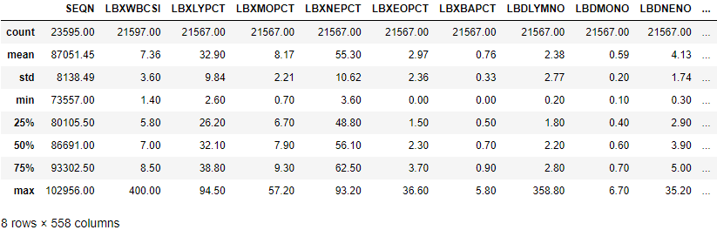
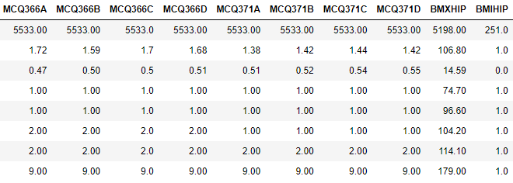
Notes:
In this slide, I present the descriptive statistics that summarize the NHANES dataset features. The statistics, such as mean and standard deviation, provide a snapshot of the data's central tendency and dispersion. I highlight anomalies, like the wide range of White Blood Cell Counts(LBXWBCSI), which may suggest outliers. I've also dealt with missing data by employing imputation methods to maintain the integrity of our analysis.

Slide 10
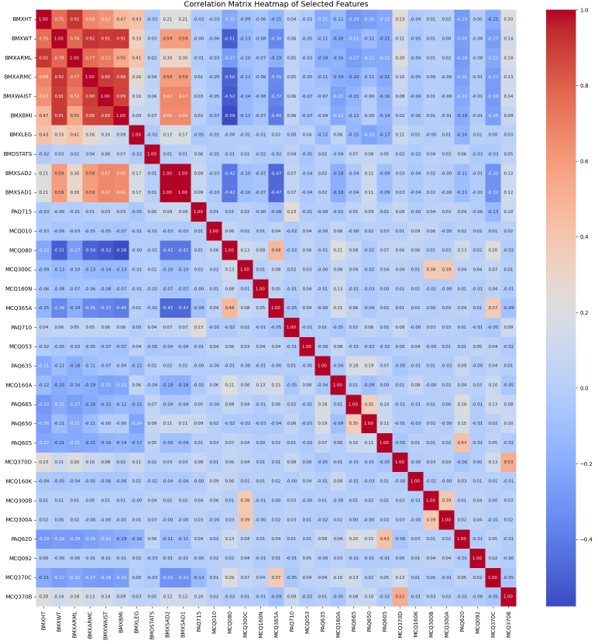
Notes:
This heatmap is a visual tool I used to discern the strength and direction of relationships between variables. High positive values indicate a strong direct relationship, while high negative values show an inverse relationship. Identifying multicollinearity is crucial, as it can impact our model's predictive power, and I used this insight for thoughtful feature selection.

Slide 11
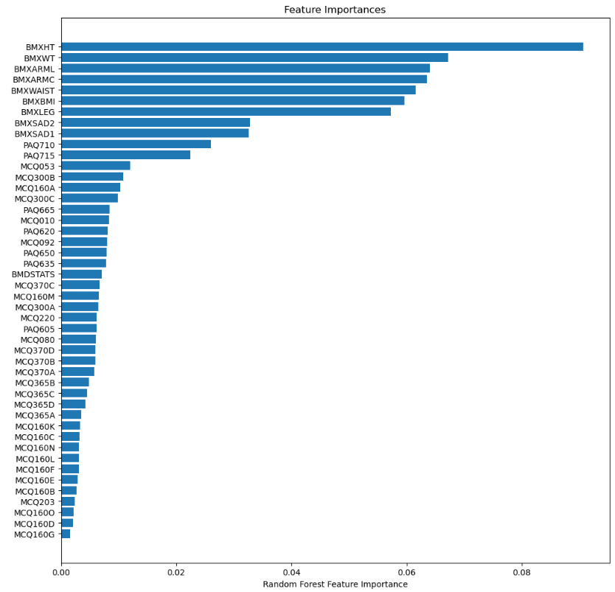
Notes:
Here, the Random Forest algorithm helped me identify the most impactful predictors of anaemia. The bar graph visualizes feature importance, guiding me to focus on the most influential variables. This step is key for building a reliable predictive model and ensuring that healthcare professionals can target the most relevant factors when addressing anaemia.

Slide 12
Detailed Analysis Results

Slide 13
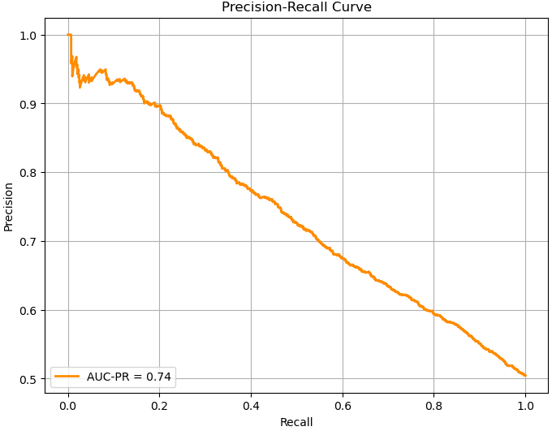
Notes:
This Precision-Recall Curve illustrates the trade-off between the precision of our predictive model and its recall ability. We aim for a balance, where we capture as many true cases of anaemia as possible (high recall), while also maintaining a high level of precision. The AUC-PR score of 0.74 indicates that our model performs well, particularly in a scenario where the cost of false negatives is high.

Slide 14
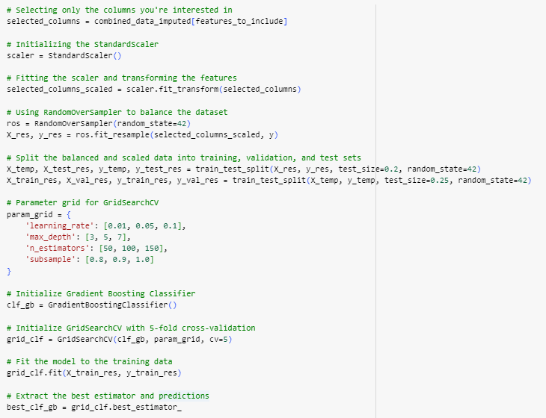
Notes:
In this section of the analysis, I've honed in on the specific features that were identified as significant. I used the StandardScaler to normalize these features to ensure that the magnitude of the variables does not bias our model. To address the issue of class imbalance, I've applied RandomOverSampler, which helps by oversampling the minority class to create a balanced dataset.
After balancing and scaling the data, I split it into training, validation, and test sets to prepare for the model training and evaluation process. I then used GridSearchCV to optimize the hyperparameters of our Gradient Boosting Classifier, ensuring that we find the best possible model configuration. The 'fit' method is where our model learns from the training data, and finally, the best estimator is determined based on cross-validation results.

Slide 15
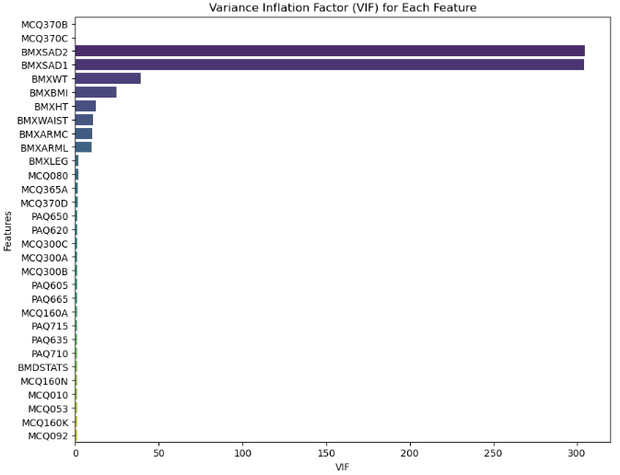
Notes:
This slide presents the VIF for each feature, which measures how much the variance of an estimated regression coefficient increases if your predictors are correlated. A VIF above 10 indicates high multicollinearity, suggesting that the variable can be predicted by other variables in the model. Here, we see that certain features like Body Weight(BMXWT) and Sagittal Abdominal Diameter(BMXSAD2) have high VIF scores, suggesting they may not provide unique predictive value to the model.

Slide 16
Conclusions &
Recommendations
Analytical Success:
Hemoglobin levels alone predicted anaemia with 83% accuracy.
Incorporation of RBC count and hematocrit increased accuracy to 94%.
Influential Factors:
Health metrics, physical activity, and medical conditions are key predictors.
Actionable Recommendations:
Comprehensive blood profiles are crucial for accurate anaemia diagnosis.
When blood data is unavailable, demographic and environmental data prove valuable.
Embrace advanced machine learning for enhanced prediction.
Prioritize robust data preprocessing for model accuracy.
Towards a Healthier Future:
Empower healthcare strategies with predictive data analytics.
Invest in technology to make early anaemia detection accessible and efficient.
Notes:
In drawing conclusions from my study, I found that hemoglobin levels alone can predict anaemia with considerable accuracy. By incorporating additional hematological markers, the predictive accuracy was significantly enhanced. The most influential factors for predicting anaemia included health metrics, physical activity, and medical conditions. My recommendation is to prioritize comprehensive blood profiling for diagnosing anaemia. Where blood data is scarce, leveraging demographic and environmental variables with advanced machine learning techniques can still offer substantial predictive value. These strategies should be integrated into healthcare practices to improve early detection and management of anaemia.

Slide 17
Thanks
Do you have any questions?
felixng2003@gmail.com
+64 022 042 6304

Slide 18
Reference List
World Health Organization (WHO) Website
Source: World Health Organization. (n.d.). Anaemia.
https://www.who.int/health-topics/anaemia#tab=tab_1
The Conversation Article
Source: The Conversation. September 9, 2023. Anemia Afflicts Nearly 1 in 4 People Worldwide, But There Are Practical Strategies for Reducing It. https://theconversation.com/anemia-afflicts-nearly-1-in-4-people-worldwide-but-there-are-practical-strategies-for-reducing-it-212177
Southern Cross Healthcare Group Website
Source: Southern Cross Healthcare Group. August 2019. Iron Deficiency Anaemia: Symptoms, Causes, and Treatment. https://www.southerncross.co.nz/medical-library/blood-and-blood-vessel-conditions/iron-deficiency-anaemia-symptoms-causes-and-treatment
ScienceDaily Article
Source: ScienceDaily. March 3, 2023. Detecting anemia earlier in children using a smartphone https://www.sciencedaily.com/releases/2023/03/230303175826.htm
PLOS ONE Journal Article
Source: Benedikt Ley. July 14, 2021. Prediction of anemia and estimation of hemoglobin concentration using a smartphone camera. PLOS ONE
https://doi.org/10.1371/journal.pone.0253495
KMS Healthcare Article
Source: KMS Staff. March 23, 2023.
5 Ethical Considerations for Implementing Machine Learning in Healthcare
https://kms-healthcare.com/5-ethical-considerations-for-implementing-machine-learning-in-healthcare/#:~:text=Despite%20its%20robust%20utility%2C%20implementing,and%20the%20impact%20on%20jobs

